Slide 1

 | S.S.V.P.S’s B. S. Deore Polytechnic, Dhule Department of Computer Engineering Academic Year : 2026-2027
SEMINAR AND PROJECT INITIATION COURSE
Sem: CO 5-K |  | SPI – 315003 | Date: 14/10/2026
Topic :Artificial Intelligence in Software testing
Roll No. |  | Name of Student
19 |  | Nikita Pravin Chaudhari
30 |  | Disha Badal Jugalkar
44 |  | Siddhi Vijay More
40 |  | Mayuri Balkrushna Mali

Slide 2
Contents
Abstract
Introduction
Literature Survey
Information to Seminar topic
Advantages and Disadvantages
Conclusion
Project Initiation :
6. 1 Description of problem statement.
6. 2 Scope and objectives.
6. 3 Stake holder
6. 4 seminar exsicussion plan
6.5 Platform/ Equipment/ Resources identification.
Bibliography
References

Slide 3
Abstract
Artificial Intelligence (AI) is changing software testing by helping teams find defects faster, generate test cases, and analyze test results. Traditional testing often requires substantial manual effort and may miss complex defects. AI based tools use techniques such as machine learning, natural language processing, and predictive analytics to support test planning, test execution, visual testing, and defect prediction. This seminar explains the role of AI in software testing, its common applications, benefits, limitations, and the resources needed to begin a small project. AI does not completely replace testers; human review remains important for correctness, security, and business understanding.

Slide 4
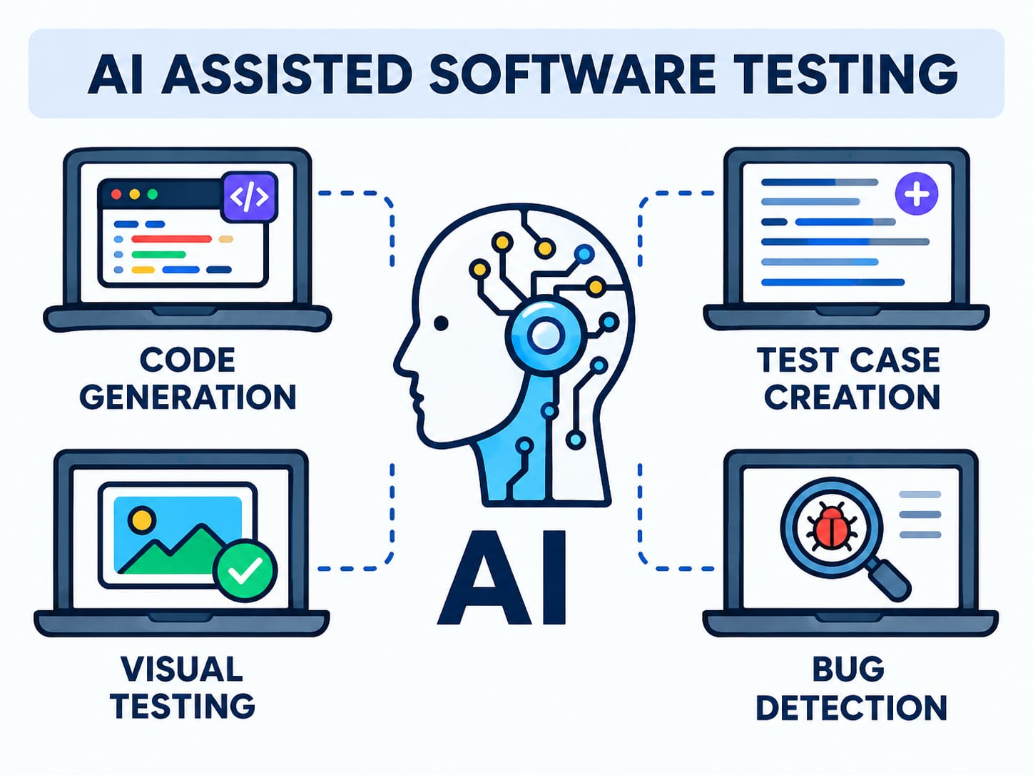
1. Introduction
Software testing is the process of checking a software application to identify defects and verify that it meets requirements. It improves quality, reliability, security, and user satisfaction. AI in software testing means using AI techniques to assist or automate testing activities. AI tools can learn patterns from code, requirements, test history, and application behaviour. They may recommend test cases, identify risky modules, maintain automated tests when interfaces change, and group similar failures.

Slide 5
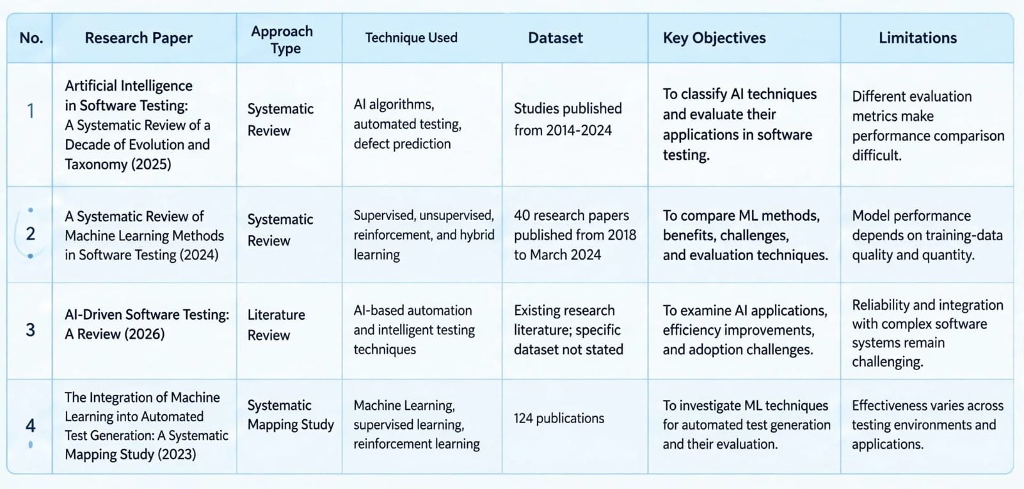
2. Literature Survey

Slide 6
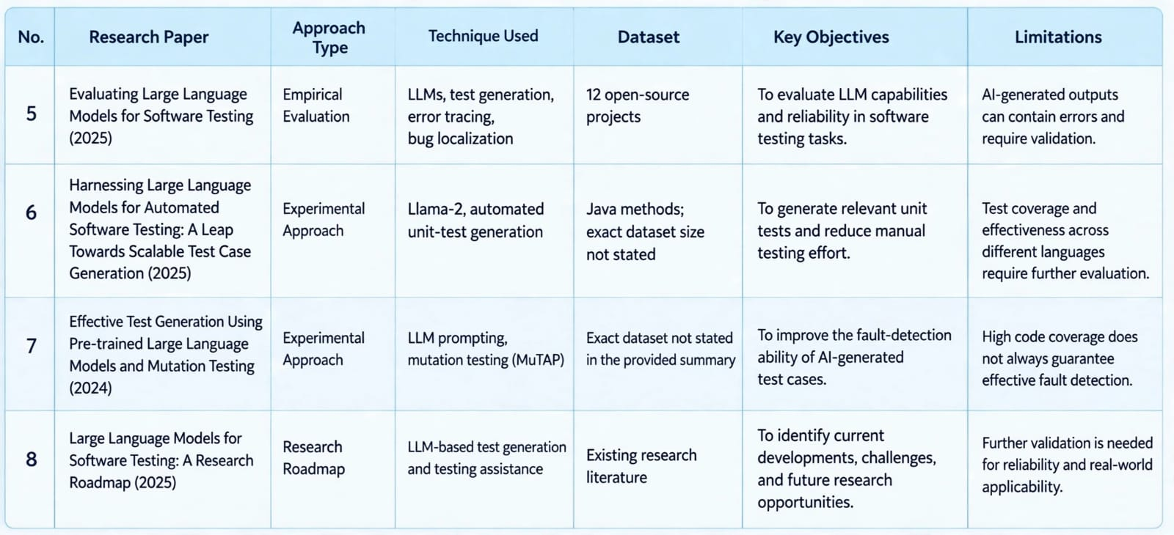

Slide 7
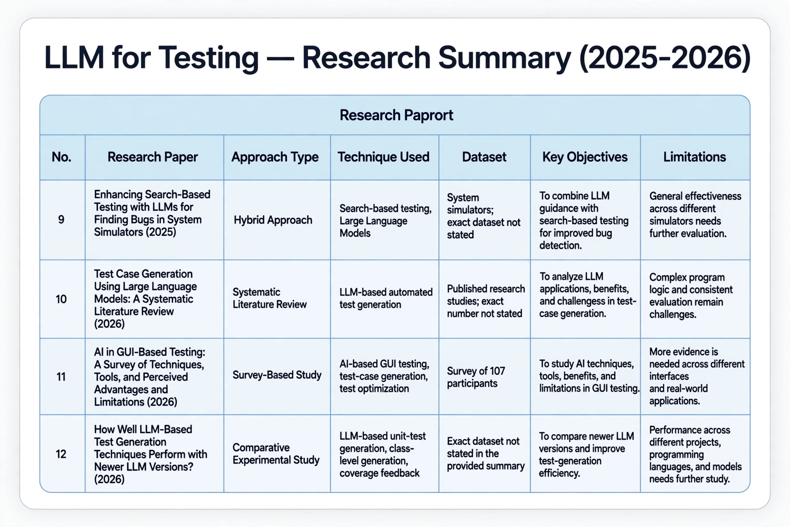

Slide 8
3. Information to seminar topic
1. Test-case generation- suggests test scenarios from requirements, code, or existing tests.
2. Test-data generation- creates varied inputs, including boundary and unusual values.
3. Test prioritisation- ranks tests based on risk, recent changes, and past failures.
4. Defect prediction- highlights modules that may need extra testing.
5. Test automation maintenance- helps identify changed UI elements or broken locators.
6. Visual testing- compares screenshots to detect layout or appearance changes.
7. Failure analysis- groups logs and failures to help find likely root causes. Typical workflow: collect requirements and test history → select an AI-enabled tool → generate or prioritise tests → execute tests → review results manually → fix defects → update test data and models.

Slide 9
4. Advantages / Disadvantages
Advantages :-
• Reduces repetitive manual work and can save testing time.
• Helps create more test scenarios and explore edge cases.
• Prioritises high-risk areas and supports faster feedback.
• Can analyse large volumes of logs and test results.
• May reduce test-maintenance effort in changing applications.
Disadvantages :-
• Tools may be costly and require specialised skills.
• Poor or biased data can produce unreliable suggestions.
• AI can generate incorrect tests or false alarms.
• Sensitive code, test data, or logs may create privacy risks.
• Results need human verification; AI cannot guarantee bug-free software.

Slide 10
5. Conclusion
AI is becoming a useful assistant in software testing. It can support test-case generation, defect prediction, test prioritization, visual testing, and failure analysis. These applications may improve speed and coverage when used with a suitable process and reliable data. However, AI outputs can be inaccurate, and privacy, cost, explainability, and maintenance must be considered. The best approach is to combine AI tools with the judgement and domain knowledge of software testers. AI supports testing; it does not guarantee that every defect will be found.

Slide 11
6. Project Initiation
Proposed mini-project:-
AI-Assisted Test Case Recommendation. The project will take a small sample software requirement or feature description and produce a list of suggested test scenarios with expected results. A tester will review and approve the suggestions before execution. Proposed demonstration: use a sample login or registration feature; prepare normal, invalid, boundary, and security-related test scenarios; compare AI suggested cases with manually prepared cases; record useful suggestions and errors. This is a prototype for learning and evaluation, not a production testing platform

Slide 12
6.1 Description of problem statement. identification.
Problem statement:-
Manual preparation and maintenance of software test cases can be time-consuming. Testers may overlook boundary conditions or unusual user inputs, especially when requirements change frequently. Repeatedly reviewing large numbers of test results can also delay defect investigation. Proposed solution: Develop a small AI-assisted prototype that accepts a clearly defined requirement and suggests relevant test cases, including positive, negative, and boundary scenarios. The tester checks the cases, edits them when necessary, and records whether they are useful. Expected outcome: A demonstrable set of AI-assisted test cases and a simple evaluation of their relevance, completeness, and accuracy. The prototype will not claim to detect all defects automatically.

Slide 13
6. 2 Scope and objectives.
Scope:-
1. Focus on one small web feature, such as login or registration.
2. Generate suggested functional test cases from a short requirement.
3. Include positive, negative, and boundary-value scenarios.
4. Allow manual review and editing of suggestions.
5. Compare AI suggestions with a small manually prepared test set.
Objectives:-
1. Understand the role of AI in software testing.
2. Reduce repetitive effort in drafting test cases.
3. Identify missing scenarios through comparison.
4. Evaluate the usefulness and correctness of suggestions.
5. Document limitations, privacy considerations, and future improvements. Out of scope: full enterprise automation, guaranteed defect detection, and unsupervised testing of production systems.

Slide 14
6. 3 Stake holder
1. Student / Project Developer: studies the topic, builds the prototype, and prepares documentation.
2. Project Guide / Faculty: provides guidance and evaluates the seminar and project plan.
3. Software Tester: reviews suggested test cases and provides feedback on usefulness.
4. Developer: uses validated test cases to identify and fix defects.
5. End User / Customer: benefits indirectly from more reliable software.
6. Institution: provides the academic framework and available laboratory resources. Human review is necessary because stakeholders must confirm that test scenarios match the actual requirements and expected behaviour.

Slide 15
6.4 Platform/ Equipment/ Resources
1. Development Platform:
Windows computer or laptop.
Python, Java, or JavaScript.
AI tools and testing frameworks.
2. System Equipment:
Computer with sufficient RAM.
Internet connection.
Selenium, PyTest, or JUnit tools.
3. Supporting Resources:
Sample source code and test cases.
Test datasets and bug reports.
Evaluation metrics for testing performance.

Slide 16
Bibliography
1.National Statistical Office, Ministry of Statistics and Programme Implementation, Government of India, Energy Statistics India 2023, 2023. Available: https://mospi.gov.in/publication/energy-statistics-india-2023
2.M. Asif, Handbook of Energy Transitions. CRC Press, 2022.
3.N. Venkatesan, J. Solanki, and S. K. Solanki, “Residential demand response model and impact on voltage profile and losses of an electric distribution network,” Applied Energy, vol. 96, pp. 84–91, 2012.
4.S. Lin, L. Zhao, F. Li, Q. Liu, D. Li, and Y. Fu, “A nonintrusive load identification method for residential applications based on quadratic programming,” Electric Power Systems Research, vol. 133, pp. 241–248, 2016.
5.X. Wu, X. Hu, X. Yin, C. Zhang, and S. Qian, “Optimal battery sizing of smart home via convex programming,” Energy, vol. 140, pp. 444–453, 2017.

Slide 17
References
1. National Statistical Office, Ministry of Statistics and Programme Implementation, Government of India, Energy Statistics India 2023, 2023. [Online]. Available: https://mospi.gov.in/publication/energy-statistics-india-2023
2. M. Asif, Handbook of Energy Transitions. CRC Press, 2022.
3. N. Venkatesan, J. Solanki, and S. K. Solanki, “Residential demand response model and impact on voltage profile and losses of an electric distribution network,” Applied Energy, vol. 96, pp. 84–91, 2012. https://doi.org/10.1016/j.apenergy.2011.12.076
4. S. Lin, L. Zhao, F. Li, Q. Liu, D. Li, and Y. Fu, “A nonintrusive load identification method for residential applications based on quadratic programming,” Electric Power Systems Research, vol. 133, pp. 241–248, 2016. https://doi.org/10.1016/j.epsr.2015.12.014
5. X. Wu, X. Hu, X. Yin, C. Zhang, and S. Qian, “Optimal battery sizing of smart home via convex programming,” Energy, vol. 140, pp. 444–453, 2017. https://doi.org/10.1016/j.energy.2017.08.097
6. K. M. Tsui and S. C. Chan, “Demand response optimization for smart home scheduling under real-time pricing,” IEEE Transactions on Smart Grid, vol. 3, no. 4, pp. 1812–1821, 2012. https://doi.org/10.1109/TSG.2012.2218835

Slide 18
7. S. Aslam, A. Khalid, and N. Javaid, “Towards efficient energy management in smart grids considering microgrids with day-ahead energy forecasting,” Electric Power Systems Research, vol. 182, article 106232, 2020. https://doi.org/10.1016/j.epsr.2020.106232
8. A. Rochd, A. Benazzouz, I. Ait Abdelmoula, A. Raihani, A. Ghennioui, Z. Naimi, and B. Ikken, “Design and implementation of an AI-based and IoT-enabled home energy management system: A case study in Benguerir—Morocco,” Energy Reports, vol. 7, pp. 699–719, 2021. https://doi.org/10.1016/j.egyr.2021.07.084
9. S. S. Hosseini, K. Agbossou, S. Kelouwani, and A. Cardenas, “Non-intrusive load monitoring through home energy management systems: A comprehensive review,” Renewable and Sustainable Energy Reviews, vol. 79, pp. 1266–1274, 2017. https://doi.org/10.1016/j.rser.2017.05.096
10. Y. Himeur, A. Alsalemi, F. Bensaali, A. Amira, and A. Al-Kababji, “Recent trends of smart nonintrusive load monitoring in buildings: A review, open challenges, and future directions,” International Journal of Intelligent Systems, vol. 37, no. 10, pp. 7124–7179, 2022. https://doi.org/10.1002/int.22876

Slide 19
Thank you

